Slide 1

Information Systems
Aviation and Tourism
Tanmay Dhimate (11012527)
Shivaji Namala (11012528)
Chinmoy Sarangi (11012375)

Slide 2

Points to Consider
Monthly Data for ease of computation
Separate dataset used in few cases due to merging issues with the existing data
Reason for taking separate data is to be able to cover various areas in our user stories.
We have also used live monitoring data via utilization of Redis.
Model is based on People experience
Also takes into considerations the complaints from neighbors near airports regarding high noise levels.

Slide 3

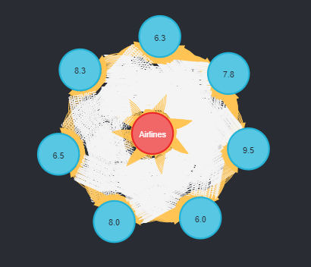
Data Model
MATCH p=()-[r:SERVICE_QUALITY]->() RETURN p LIMIT 25

Slide 4

User Story 1
Airlines want to optimize their routes, but they find passengers taking alternative flight routes instead of regular ones.
They want to go beyond the usual metrics of changing number of flights or cutting down services, to improve their profit margins and seat occupancy.
This is answered via Neo4j.

Slide 5

User Story 2
As a travel destination, Europe is the most preferred choice in the world.
But due to the Coronavirus situation, the airlines have suffered massive
losses in terms of revenue and human resources.
So, they want to see what destinations can provide them maximum returns
Once the borders are open for air travel.
This is answered via MongoDB.

Slide 6

User Story 2 (cont…d)
Query:
db.routes_data.aggregate(
[
{
$group :
{
_id : "$destinationCountry",
total: { $sum: 1}
}
},
// Second Stage
{
$match: { "total": { $gte: 100 } }
}, {$project:{"destinationCountry":1, "total":1} } , { $sort : { "total" : -1 } } ,{ $limit : 10 }
]
)
Output:
{ "_id" : "United Kingdom", "total" : 5270 }
{ "_id" : "Spain", "total" : 5060 }
{ "_id" : "Germany", "total" : 4672 }
{ "_id" : "France", "total" : 3842 }
{ "_id" : "Russia", "total" : 3622 }
{ "_id" : "Italy", "total" : 3558 }

Slide 7





User Story 3
REST API
Buffer DB
Main DB
Philipp is member of air traffic control team in US. He wants to know the flight numbers coming from each country. The Input will have only "Country of Origin" and "Co-ordinates" of current position.
This is needed so that Phillipp can provide the incoming flight details to his supervisor for effective reporting.
This is covered via MongoDB

Slide 8
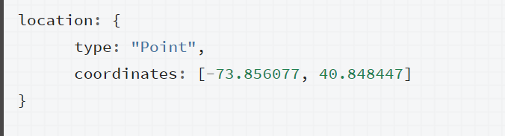
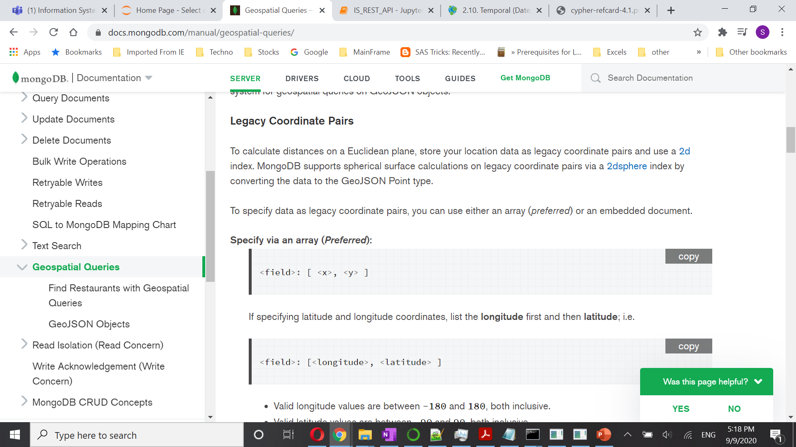
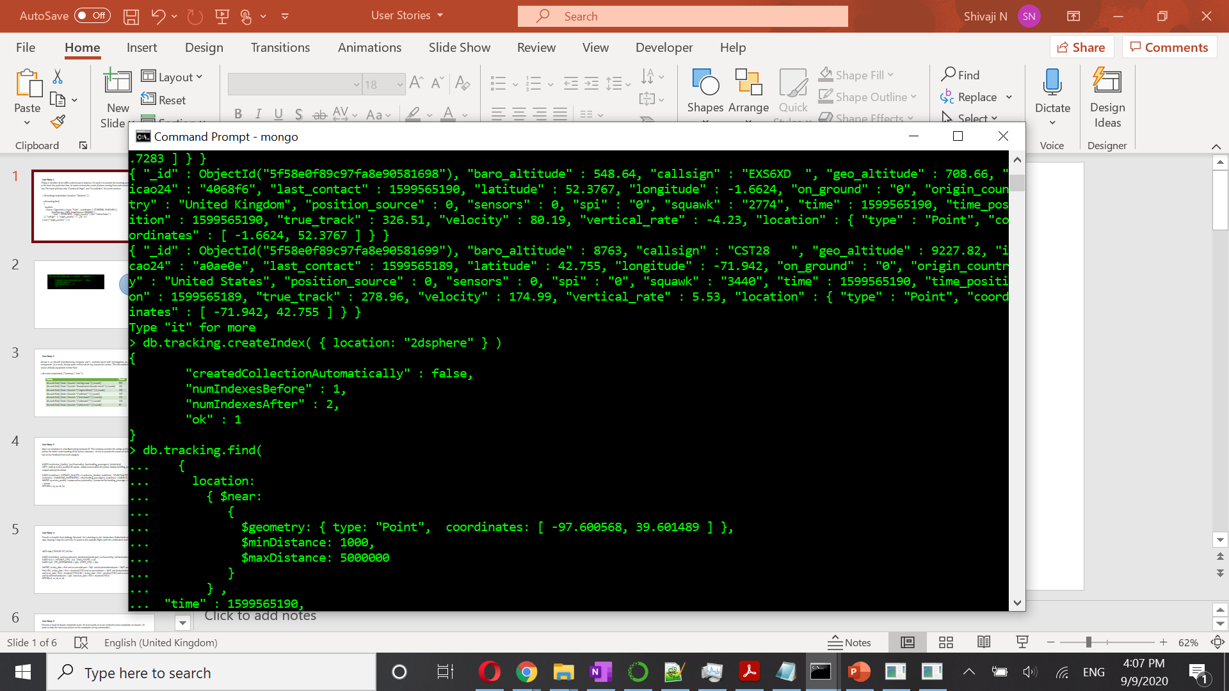
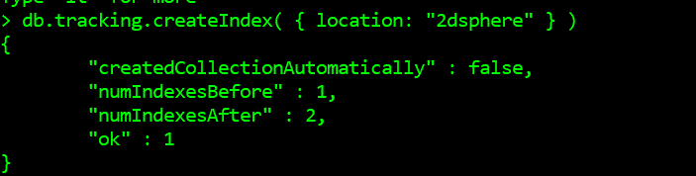
User Story 3 (cont…d)
GeoJSON Point: Legacy Coordinate Pairs:
Input:
Location 2d sphere Index:

Slide 9
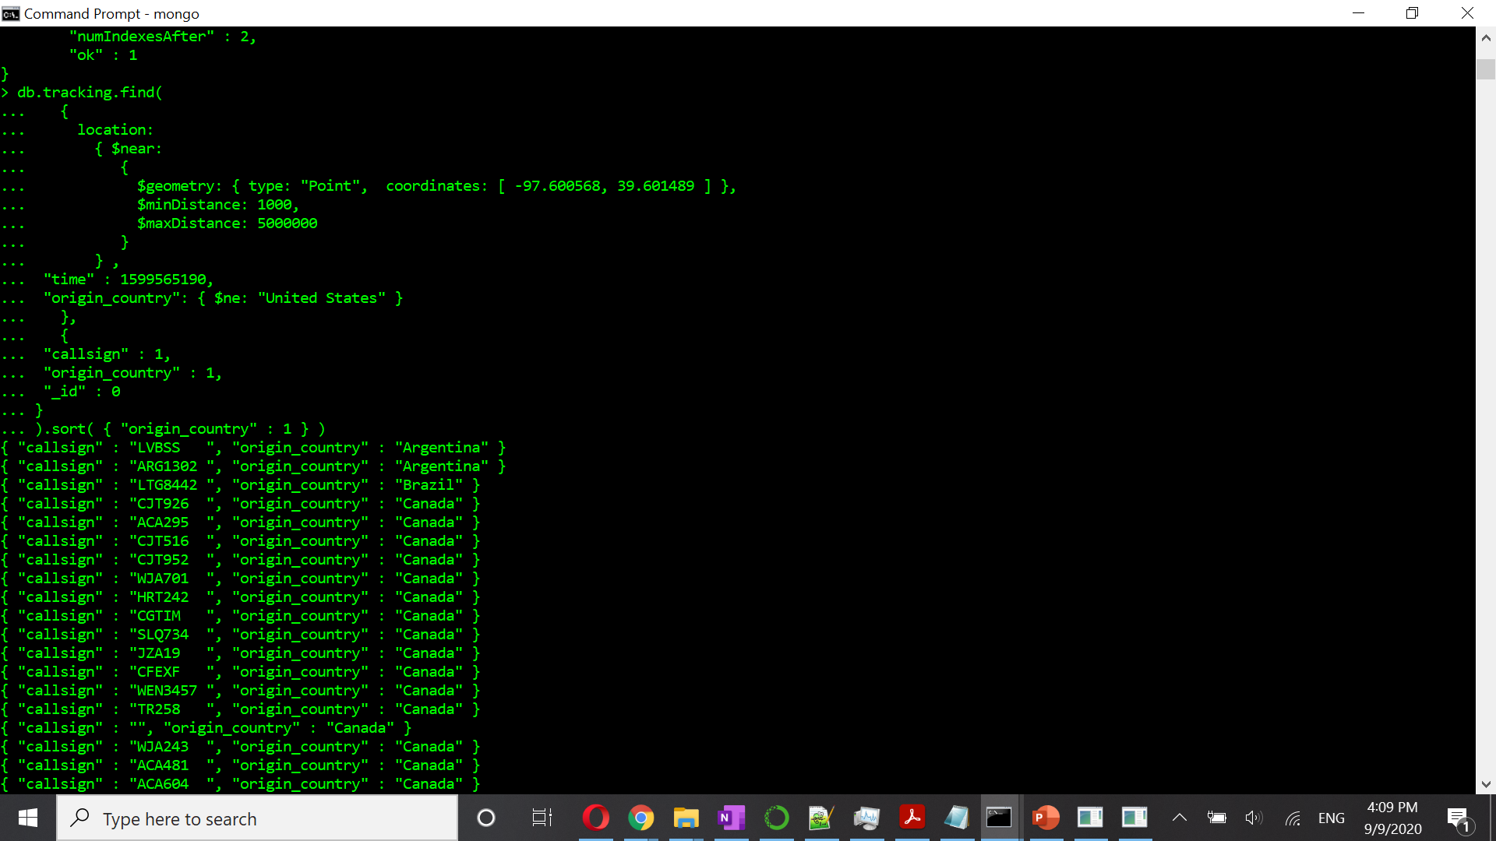
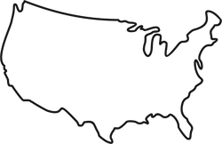

User Story 3 (cont…d)
Query:
R
Output:

Slide 10
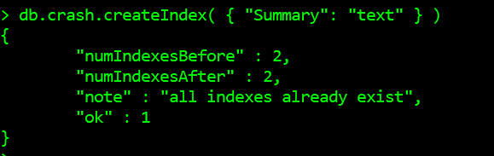

User Story 4
Airmax is an Aircraft Manufacturing Company and is routinely subjected to investigations on faulty aircraft hardware components. As a result, Airmax wants to find out the top reasons for the faulty parts. This will enable the company to track the source of faulty equipment in their fleet.
This is answered via MongoDB
Text Index:

Slide 11
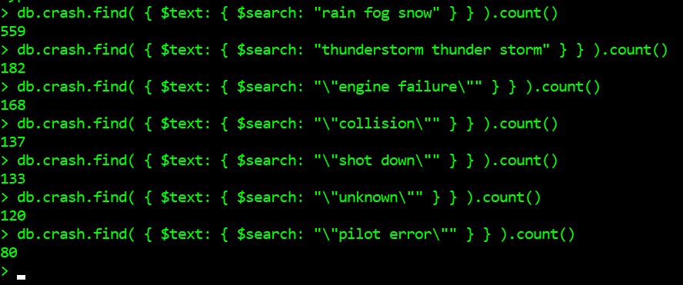
User Story 4 (cont…d)
Query & Output:

Slide 12

User Story 5
Alex is an employee in a feedback rating company XZ. This company provides the ratings and feedbacks of the airlines for better understanding of the airline customers. He has to provide the names of airlines which received top service feedback from each category.
Query :
MATCH (sq:Service_Quality) , (pu:Punctuality), (hp:Handling_passengers), (ah:AirHelp)
WITH max(sq.service_quality) AS sqmax , max(pu.punctuality) AS pumax, max(hp.handling_passenger) AS hpmax, max(ah.airhelp) AS ahmax
MATCH (a:Airlines) - [:SERVICE_QUALITY] -> (sq:Service_Quality), (a:Airlines) - [:PUNCTUALITY] -> (pu:Punctuality), (a:Airlines) - [:HANDLING_PASSENGERS] -> (hp:Handling_passengers), (a:Airlines) - [:AIRHELP] -> (ah:AirHelp)
WHERE sq.service_quality = sqmax and pu.punctuality = pumax and hp.handling_passenger = hpmax and ah.airhelp = ahmax
RETURN a, sq, pu, ah, hp

Slide 13

User Story 6
Pascal is a traveller from Aalborg, Denmark. He is planning to visit Amsterdam, Netherlands and Oslo, Norway in four days, keeping 2 days for each City. He wants to the available flights with this combination starting from 15th Sep 2020.
Query :
WITH date("2020-09-15") AS first
MATCH (al:Airline), (sa:SourceAirport), (da:DestinationAirport), (sc:SourceCity), (dc:DestinationCity)
MATCH (sc) <- [:SOURCE_CITY] - (sa) - [:HAS_FLIGHT] -> (al)
MATCH (al) - [:TO_DESTINATION] -> (da) - [:DEST_CITY] -> (dc)
WHERE ( al.dep_date = first and sa.sourceAirport = 'AAL' and da.destinationAirport = 'AMS' and al.arr_date = first) OR ( al.dep_date = first + duration('P2D') and sa.sourceAirport = 'AMS' and da.destinationAirport = 'OSL' and al.arr_date = first + duration('P2D')) OR ( al.dep_date = first + duration('P4D') and sa.sourceAirport = 'OSL' and da.destinationAirport = 'AAL' and al.arr_date = first + duration('P4D'))
RETURN al, sa, da, sc, dc

Slide 14

User Story 7
Krischan is head of Airport complaints team. His team works on noise complaints on airports caused due to various factors. He wants to take necessary actions on the complaints based on top communities.
Query & Output:
MATCH (c:Community) - [r:COMPLAINTS] -> (com:Total_complaints)
RETURN c, SUM(com.complaints) AS Total
ORDER BY Total DESC
LIMIT 3

Slide 15

User Story 8
User Story 11
Central Data Set
User Story 12
User Story 13
4

Slide 16
Data BASE – User story 11
As a Business traveler , I wish to see the average delay for an airline for a specific route so as to book a flight with less average delays.

Slide 17
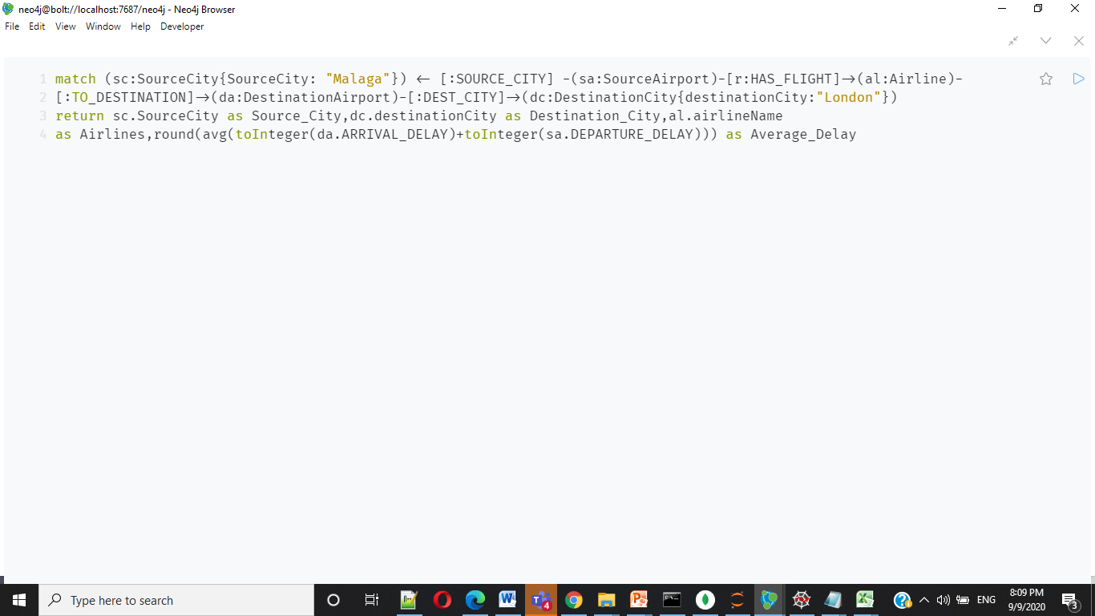
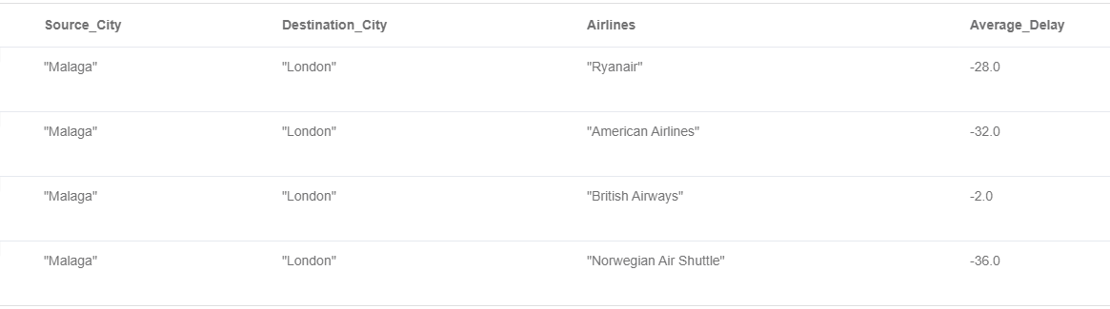
Data BASE – User story 11

Slide 18
Data BASE – User story 12
I wish to find make new friends over long flight journey , hence would like to check the availability of a Travel App for a specific journey Route.

Slide 19
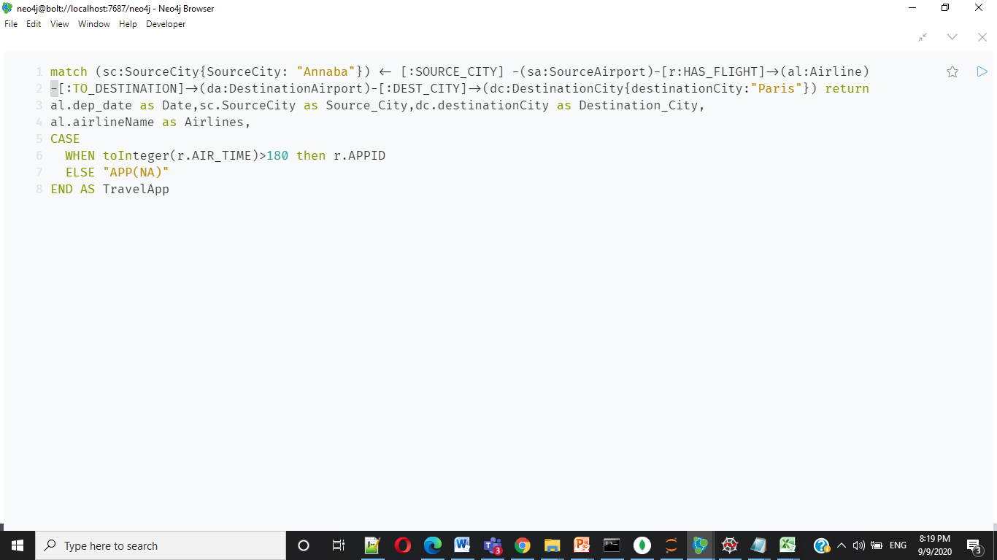
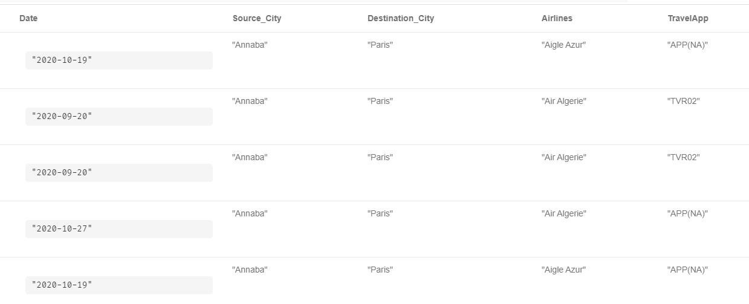
Data BASE – User story 12

Slide 20
Data BASE – User story 13
I wish to find an average ratings of various airline services for a specific Route.

Slide 21
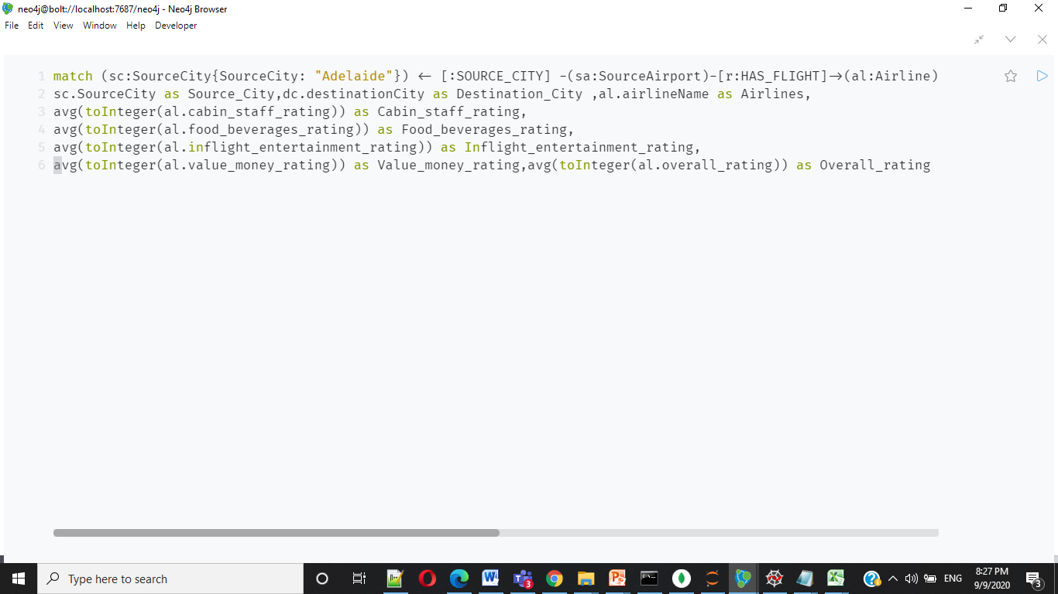
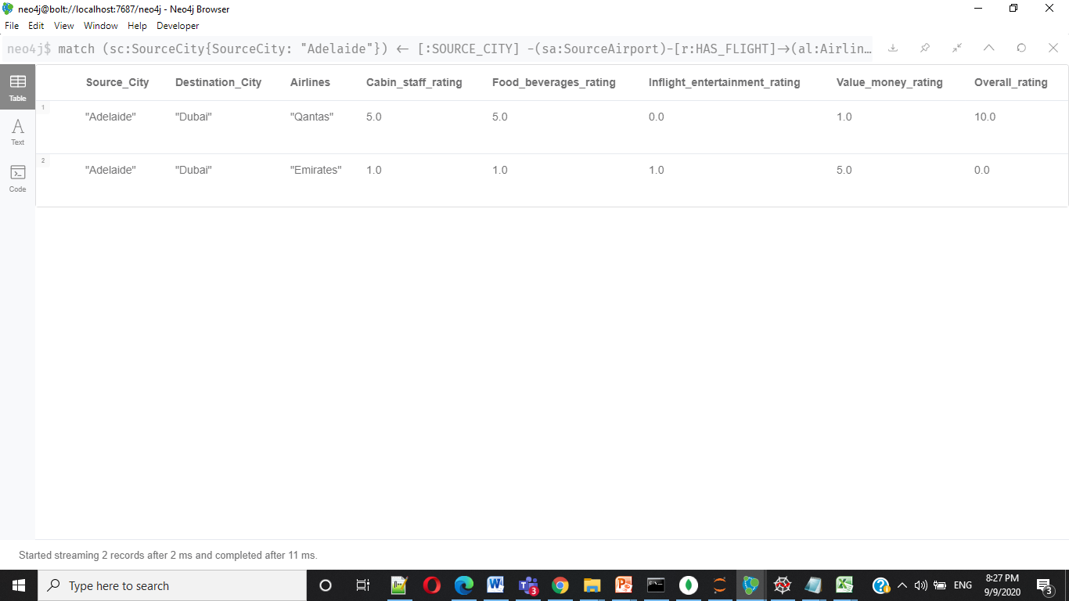
Data BASE – User story 13

Slide 22
Data BASE – REDIS
Opensky API
4

Slide 23
Data BASE – REDIS
Opensky API
{'hat:1326692461': {'longitude': -43.3196, 'latitude': -22.5643},
'hat:1236154736': {'longitude': -47.6275, 'latitude': -16.441},
'hat:56854717‘ : {'longitude': -48.2881, 'latitude': -13.3753}…..}
4

Slide 24

Data BASE – REDIS
hmset()
Opensky API
{'hat:1326692461': {'longitude': -43.3196, 'latitude': -22.5643},
'hat:1236154736': {'longitude': -47.6275, 'latitude': -16.441},
'hat:56854717‘ : {'longitude': -48.2881, 'latitude': -13.3753}…..}
4

Slide 25
Data BASE – REDIS
hmset()
hgetall()
Opensky API
User Story 4
4

Slide 26

Data BASE – REDIS
hmset()
hgetall()
Opensky API
User Story 4
4

Slide 27
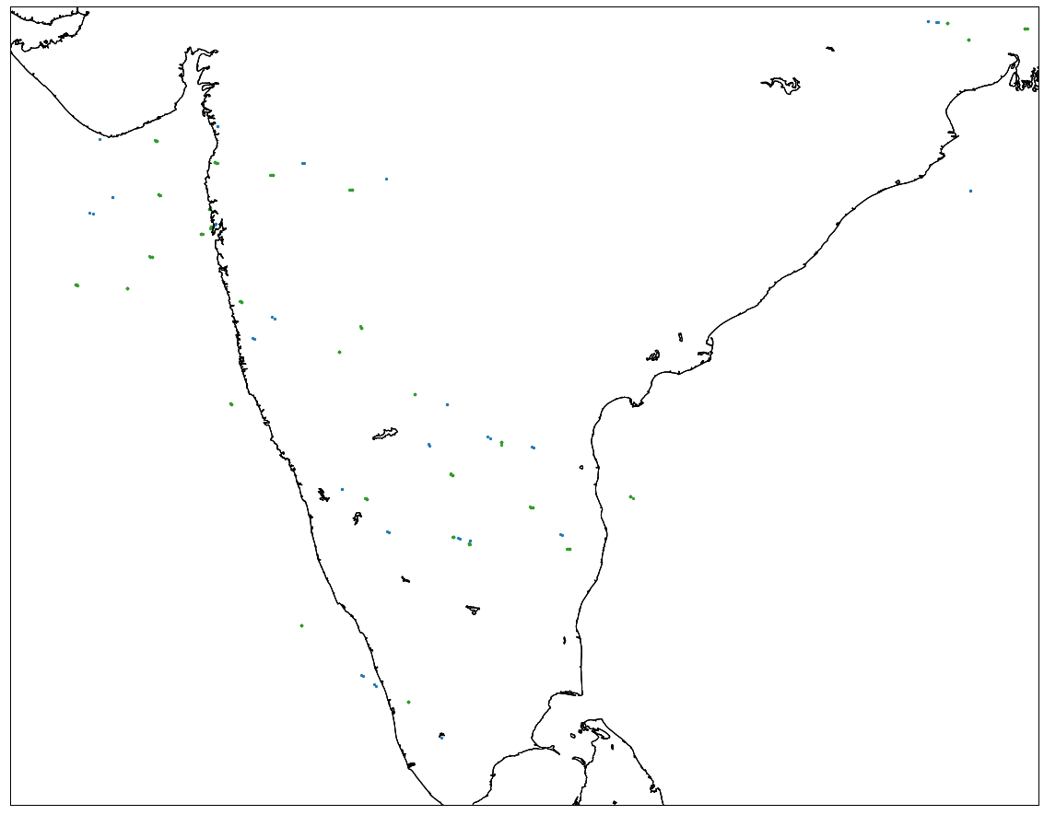
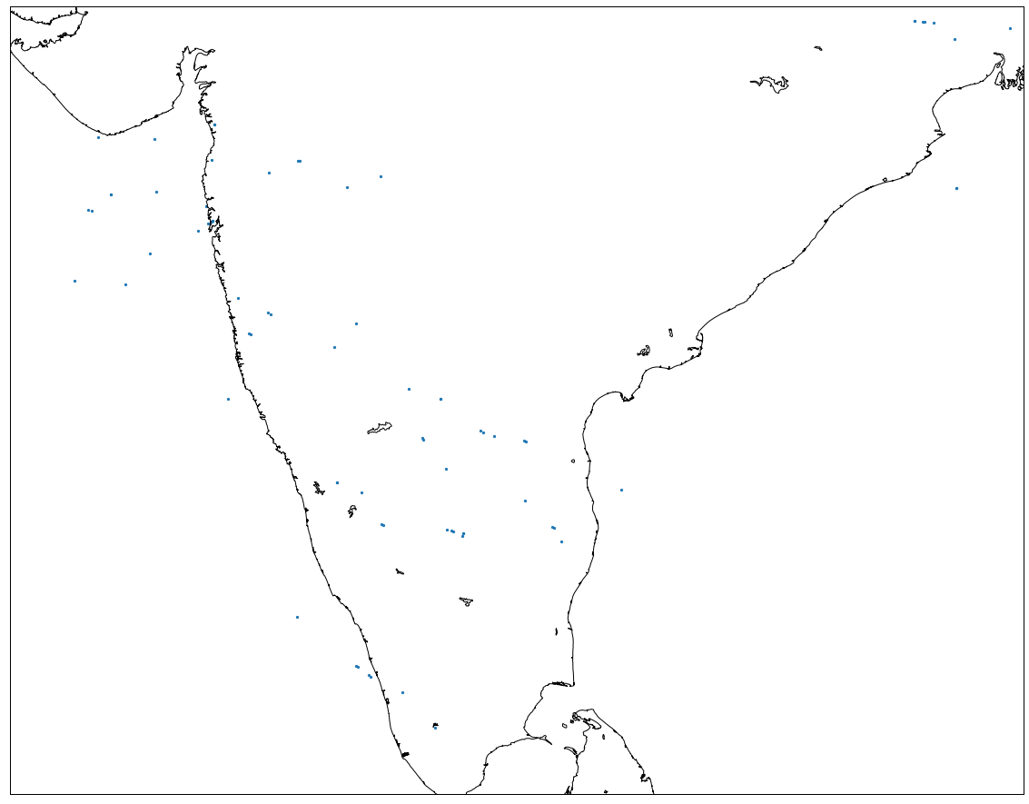
User story 14 : LIVE AIR TRAFFIC

Slide 28
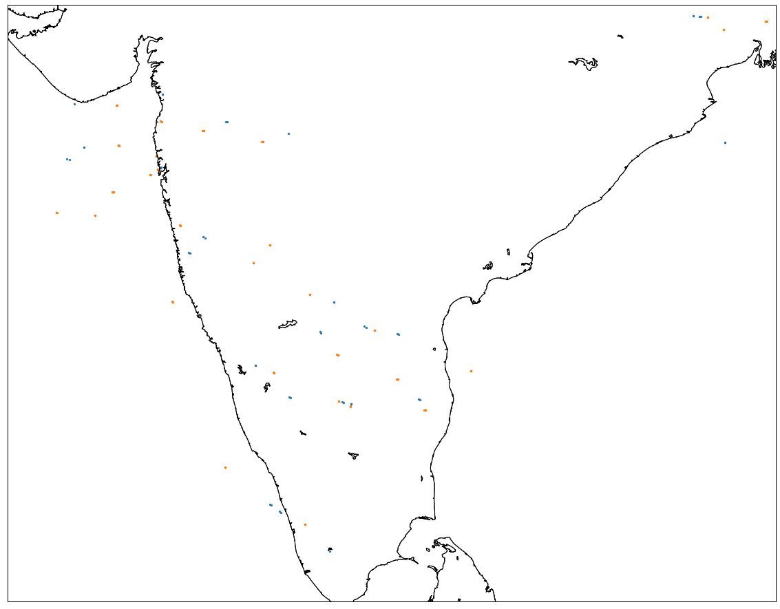
User story 14 : LIVE AIR TRAFFIC

Slide 29
User story 4 : LIVE AIR TRAFFIC

Slide 30
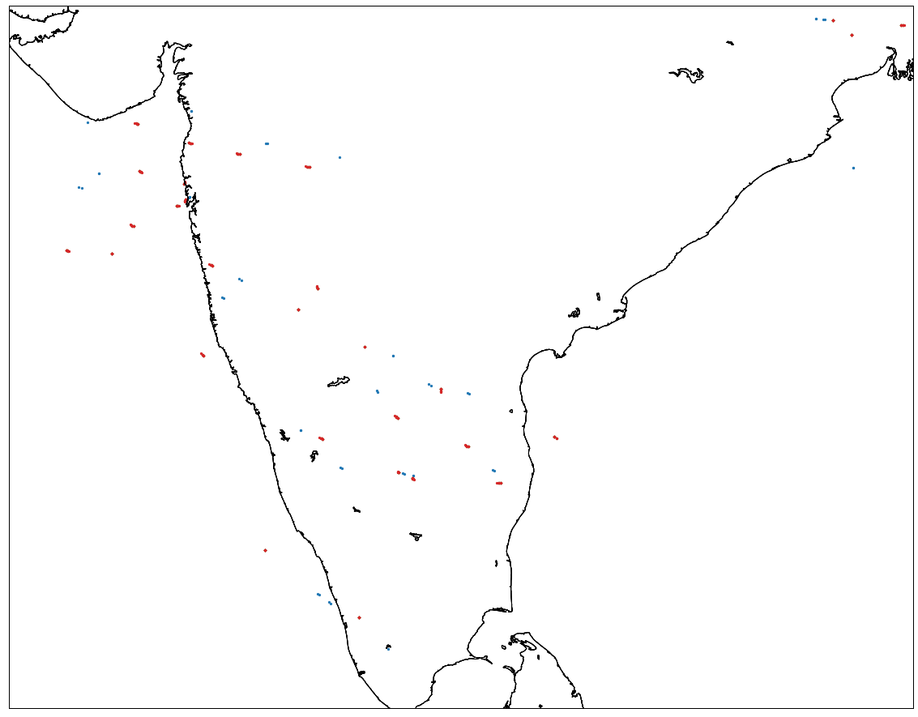
User story 14 : LIVE AIR TRAFFIC

Slide 31
User story 14 : LIVE AIR TRAFFIC

Slide 32
User story 14 : LIVE AIR TRAFFIC

Slide 33
DataBASE – MONGODB
Sentiment Analysis
Skytrax
Topic Modelling
WordCloud
4

Slide 34

Thank You

